Slide 1
The Reinforcement Learning Problem

Slide 2
Objectives
Reinforcement Learning
Agent and Environment
State Space and Observations
Actions and Rewards
The learning cycle
Steps and Episodes
Experience
Delayed consequences
Markov Decision Process
Markov Property
The Transition function
The Reward function
The Return
The Discount
MDP framework
Example: the frozen lake
Plan vs Policy

Slide 3
Reinforcement Learning
Humans naturally look for happiness
from picking out our meals…
…to advancing our careers
Every action we choose is derived from our willing to experience rewarding moments in life
immediate gratification or long-term success
they’re still our perception of how important and valuable they are
The ability to achieve these precious moments seems to be correlated with intelligence
the ability to acquire and apply knowledge and skills
Reinforcement learning (RL) is the task of learning through trial and error
no human labels data
no human collects or explicitly designs the collection of data
the goal in RL is to act

Slide 4
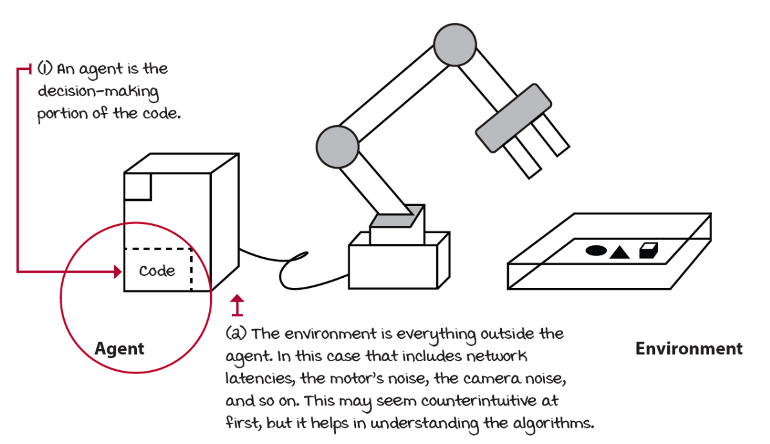
Agent and Environment
The agent is not told which actions to take, it must discover which actions provide the most reward by trying them on its environment
everything outside the agent
everything the agent has no total control over
The objects to be picked up, the tray where the objects lay, the wind, the robot arm and everything outside the decision maker are part of the environment.

Slide 5
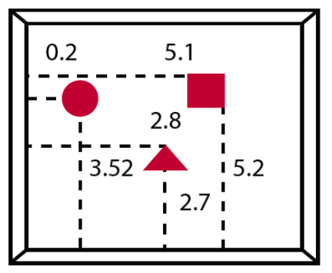

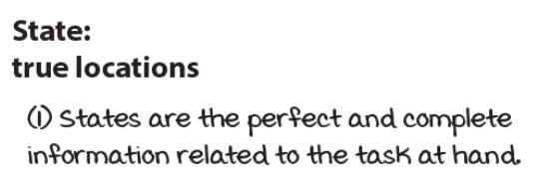
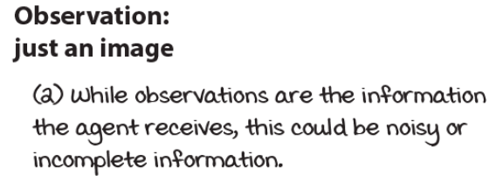
State Space and Observations
The environment is represented by a set of variables related to the problem
in the robotic arm example: location and velocities of the arm
This set and all the possible values that variables can take are referred to as the state space
a state is an instantiation of the state space: a set of values the variables take
Often, agents don’t have access to the actual full state of the environment: the part of a state that the agent can observe is called an observation
in the robotic arm example, the agent may only have access to camera images

Slide 6
Actions and Rewards
At each state, the environment makes available a set of actions the agent can choose from
the agent influences the environment through these actions
the environment may change states as a response to the agent’s action
transition function
The environment also provides a reward signal as a response
reward function
The set of transition and reward functions is referred to as the model of the environment
In the interesting and challenging cases, actions may affect not only the immediate reward and the next situation, but also all subsequent rewards

Slide 7
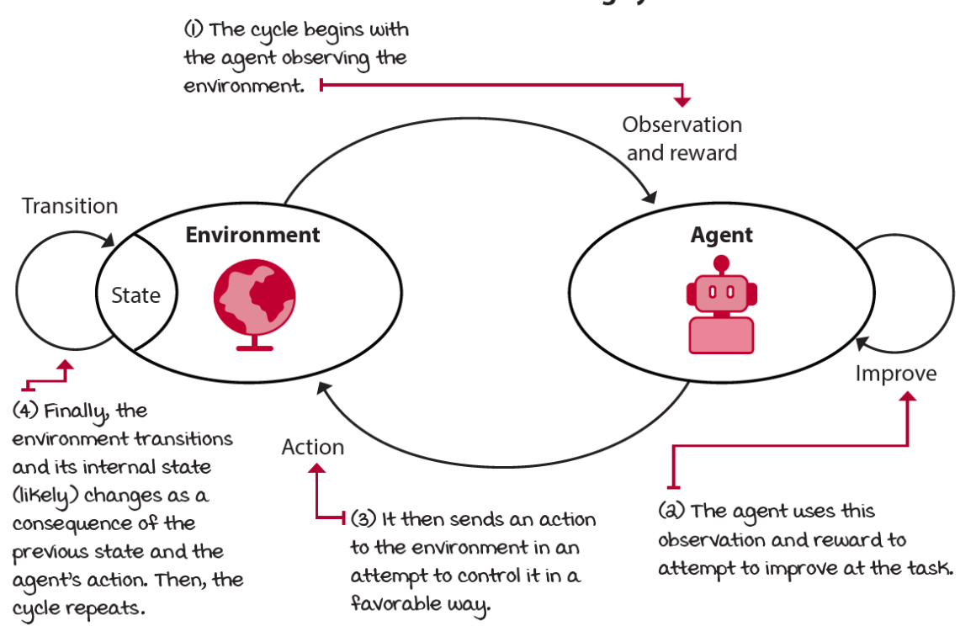
The learning cycle (1)

Slide 8
Steps and Episodes
The agent has a three-step process:
interaction with the environment,
evaluation of the behaviour using the reward signal
improvement of responses
Each cycle is called a time step
at each time step, the agent observes the environment, takes action, and receives a new observation and reward
the set of [state, action, reward, new state] is called an experience
The task may or may not have a natural ending
tasks that have a natural ending (e.g. games) are called episodic tasks
tasks that don’t have a natural ending continuing tasks
The sequence of time steps from the beginning to the end of an episodic task is called an episode

Slide 9
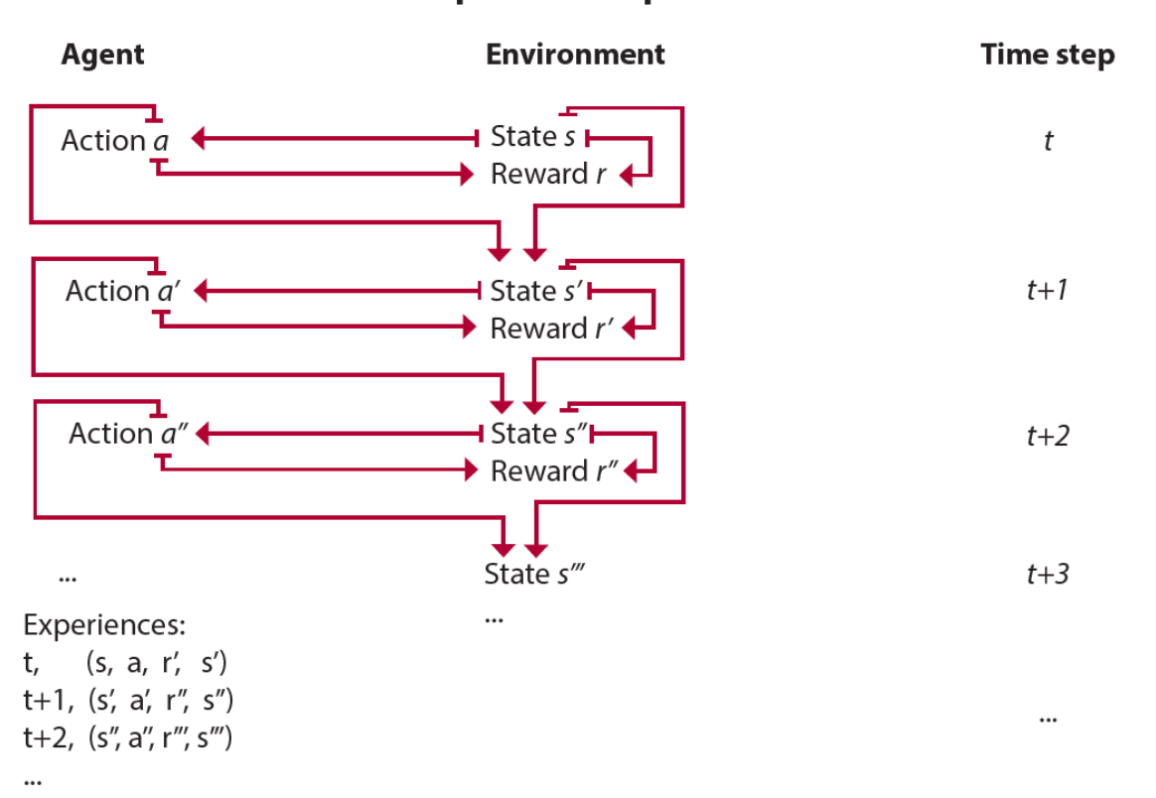
Experience

Slide 10
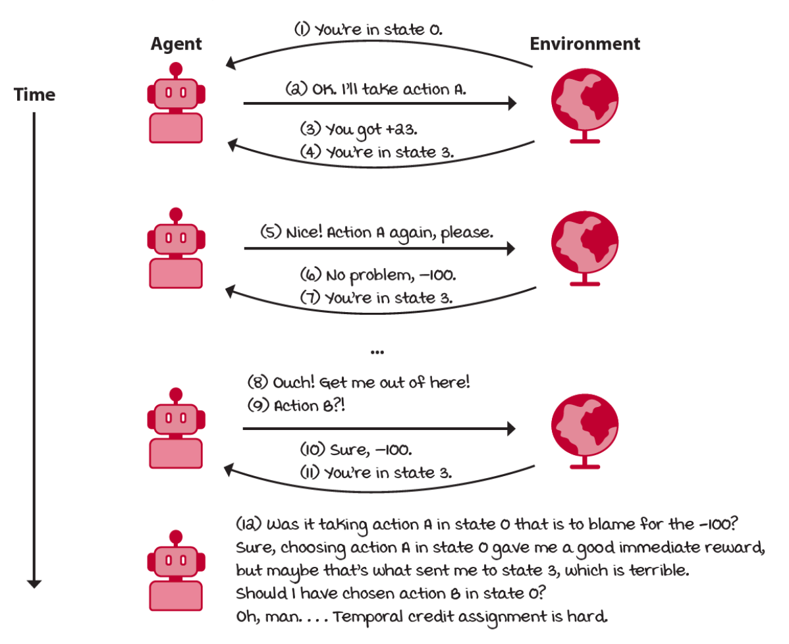
Delayed consequences
The reward may be sparse and only manifest after several time steps
Thus the agent must be able to learn from sequential feedback
temporal credit assignment problem
how to determine which state/action is responsible for a reward?

Slide 11
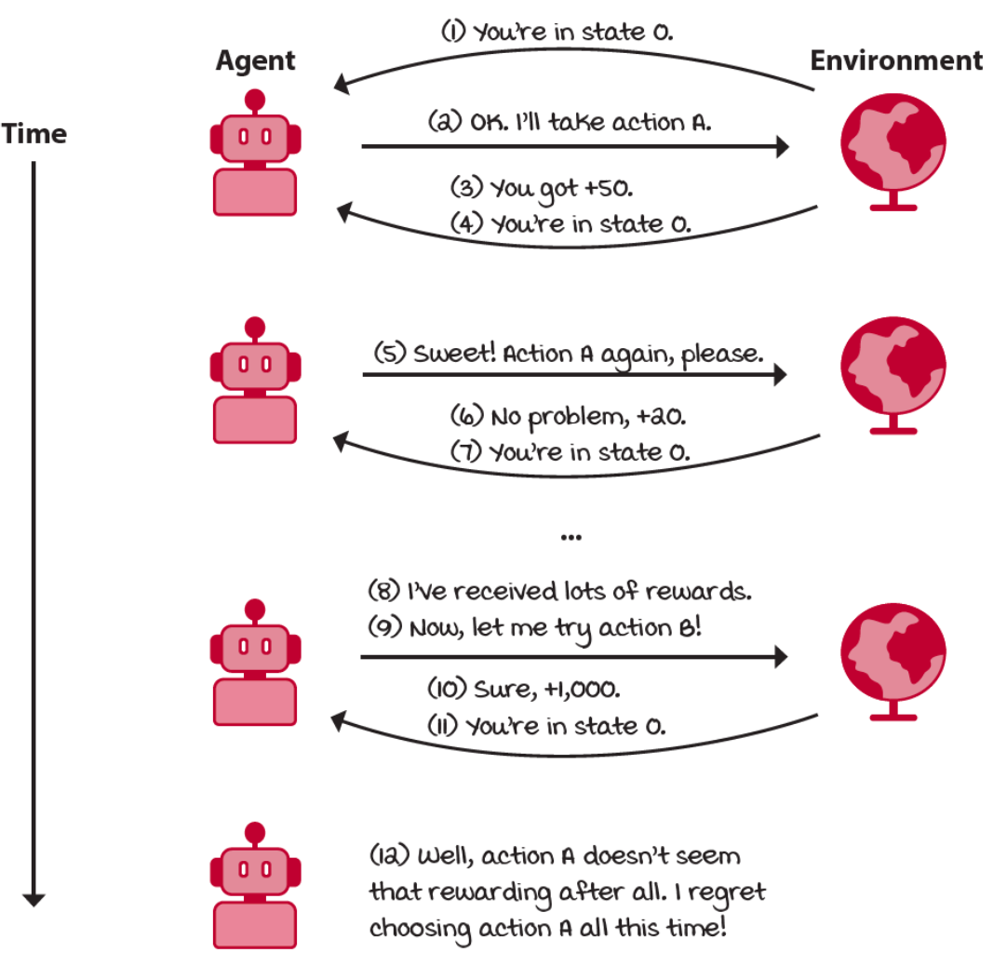
Exploration vs Exploitation
The reward may be weak: it don’t contain information about other potential rewards
exploration versus exploitation trade-off

Slide 12

Markov Decision Process
A mathematical framing for the problem of learning from interaction to achieve a goal
the agent and environment interact at each of a sequence of discrete time steps 𝑡=0,1,2,3,...
at each time step 𝑡, the agent receives a representation of environment's state 𝑆_{𝑡} from a state space 𝑆
on that basis it selects an action 𝐴_{𝑡} from a set of actions 𝐴
one time step later, in part as a consequence of its action, the agent receives a numerical reward 𝑅_{𝑡+1} and finds itself in a new state 𝑆_{𝑡+1}
The environment and the agent together give rise to a sequence or trajectory
A starting states is a state to begin interacting with the environment
A terminal state has all available actions transitioning, with probability 1, to itself, and these transitions provide no reward

Slide 13
Markov Property
We assume that the probability of the next state, given the current state and action is independent of the history of interactions
memoryless property is known as the Markov property
the probability of moving from one state to another state on two separate occasions, given the same action, is the same regardless of all previous states or actions encountered before that point
Most RL agents are designed to take advantage from this assumption, we must make sure we feed our agent the necessary variables to make it hold as tightly as possible
completely keeping the Markov assumption is impractical, perhaps impossible
the more variables we add, the longer it takes to train an agent
the fewer variables, the higher the chance the information fed to the agent is not sufficient, and the harder it is to learn anything useful

Slide 14

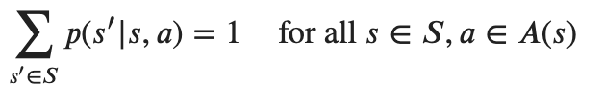
The Transition function
The way the environment changes as a response to actions
maps a transition tuple (𝑠,𝑎,𝑠′) to a probability
the probability of transition from state 𝑠 to state 𝑠′ when taking action 𝑎.
Notice that integrating over the next states (as any probability distribution) must equal one
One key assumption is that this distribution is stationary
while there may be highly stochastic transitions, the probability distribution don’t change during training or evaluation
the assumption is often relaxed
however, it’s important to interact with environments that at least appear to be stationary (the change is slow)

Slide 15
The reward function
A numeric signal of goodness of transitions
maps a transition tuple (𝑠,𝑎,𝑠′) to a scalar R
The use of a reward signal to formalize the idea of a goal is one of the most distinctive features of reinforcement learning
if we want the agent to do something for us, we must provide rewards to it in such a way that in maximizing them the agent will also achieve our goals
It is critical that the rewards we set up truly indicate what we want accomplished
Formally, we can define the reward function as the expected value of reward given the state-action-state tupla:
Notice that the reward is our way of communicating to the agent what we want it to achieve, not how we want it achieved

Slide 16
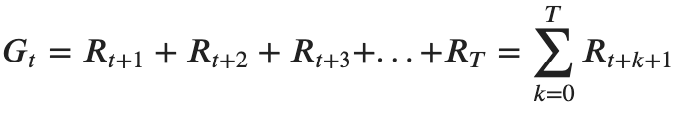
The Return
The agent’s goal is to maximize the total amount of reward it receives
not immediate reward, but cumulative reward in the long run
Return 𝐺𝑡: the sum of all rewards obtained during the course of an episode
T is a "final" time step
for episodic tasks the agent–environment interaction breaks naturally int sub-sequences (e.g. plays a game, trips through a maze) and 𝑇 has a finite value
for continuing tasks, the agent–environment interaction does not break naturally, but goes on continually without limit (e.g. an on-going process-control) and 𝑇=∞

Slide 17
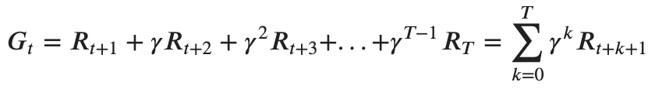
The Discount
We can have possibility of infinite sequences of time steps (unboundedness), so we need a way to discount the value of rewards over time
tell the agent that getting +1’s is better sooner than later
We use a positive real value (<1) to exponentially discount the value of future rewards
the further into the future we receive the reward, the less valuable it is in the present
this number is called the discount factor 𝛾
Notice an interesting recursive definition which show that the returns at successive time steps are related to each other:

Slide 18
MDP framework
The MDP framework is abstract and flexible and can be applied to many different problems in many different ways
actions can be low-level controls (the voltages applied to the motors of a robot arm)
or high-level decisions (whether or not to have lunch)
states can take a wide variety of forms
can be completely determined by low-level sensations (direct sensor readings)
can be more high-level and abstract (symbolic descriptions of objects in a room)
In general, actions can be any decisions we want to learn how to make, and the states can be anything we can know that might be useful in making them!
There are many extensions to the framework
Partially observable Markov decision process: when the agent cannot fully observe the environment state
Continuous Markov decision process: when time, action, state or any combination of them are continuous
Multi-agent Markov decision process: to allows the inclusion of multiple agents in the same environment

Slide 19
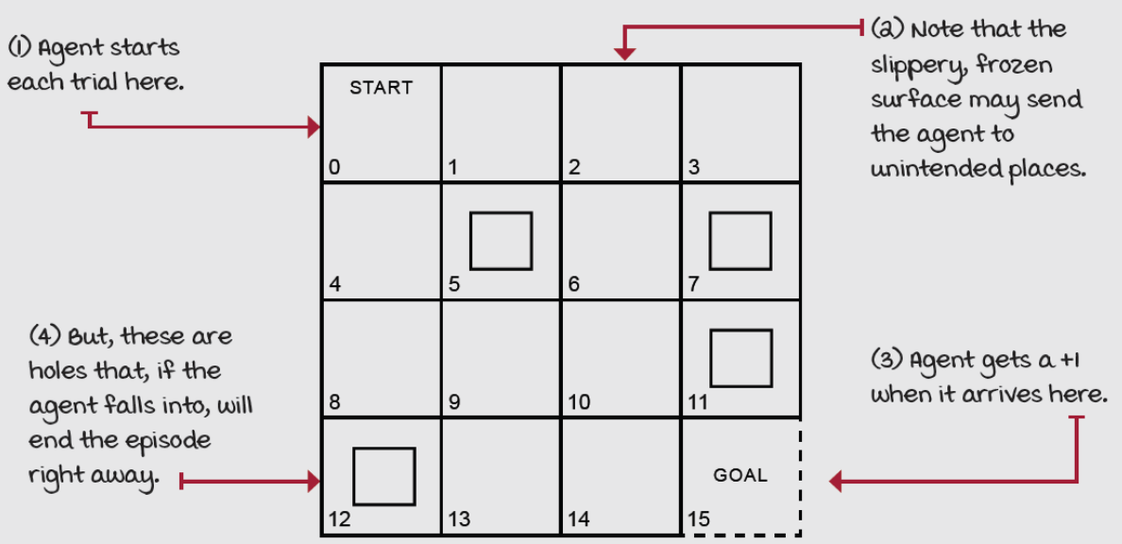
Example: the frozen lake (1)
A simple grid-world environment
discrete state and action spaces
the task is to go from a start to a goal location, avoiding falling into holes
the challenge is that the surface is slippery: the agent moves only a third of the time as intended, the other two-thirds are split evenly in orthogonal directions

Slide 20
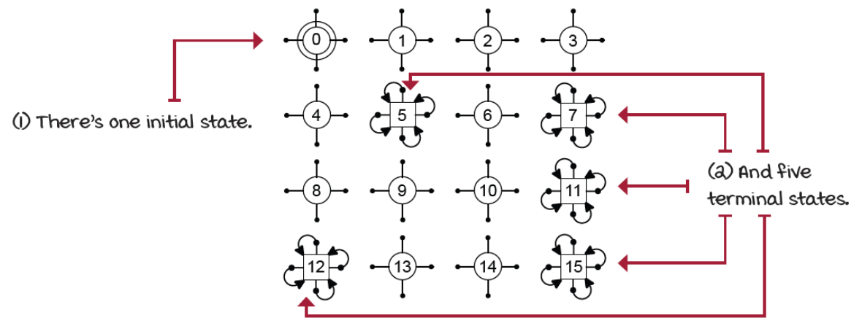
Example: the frozen lake (2)
The state is composed of a single variable: the id of the cell where the agent is at any given time
the size of the state space is 16 (the ids are set from 0 to 15, left to right, top to bottom)
there’s only one starting state (which is state 0)
five terminal states:

Slide 21
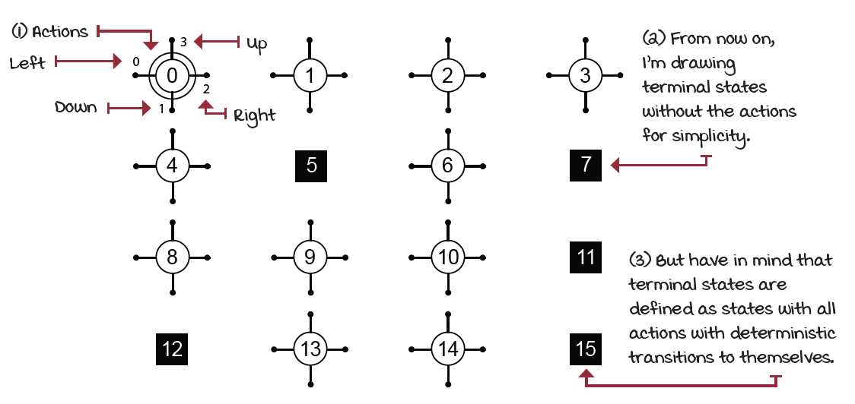
Example: the frozen lake (3)
There are four available actions in all states
Up, Down, Right, or Left

Slide 22
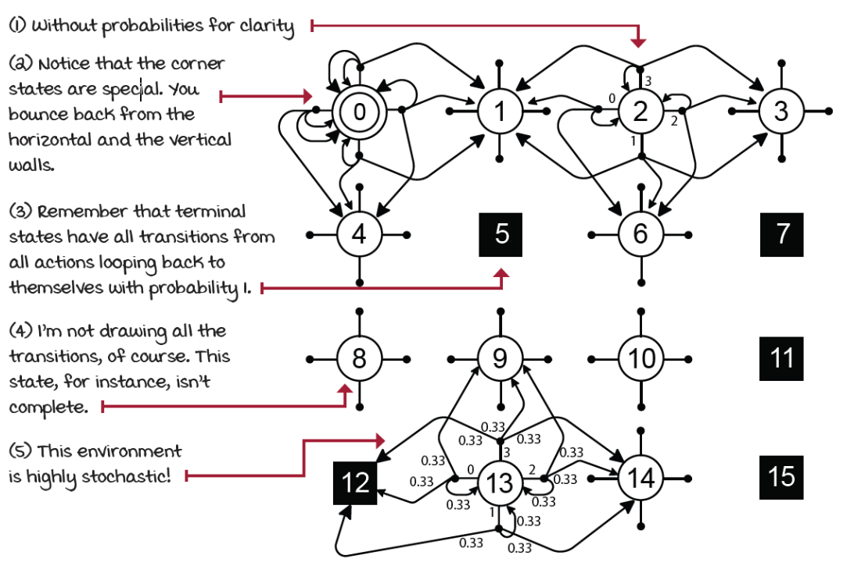
Example: the frozen lake (4)
The environment is stochastic
the probability of the next state 𝑠′ given the current state 𝑠 and action 𝑎 is less than 1
there are more than one possible next state

Slide 23
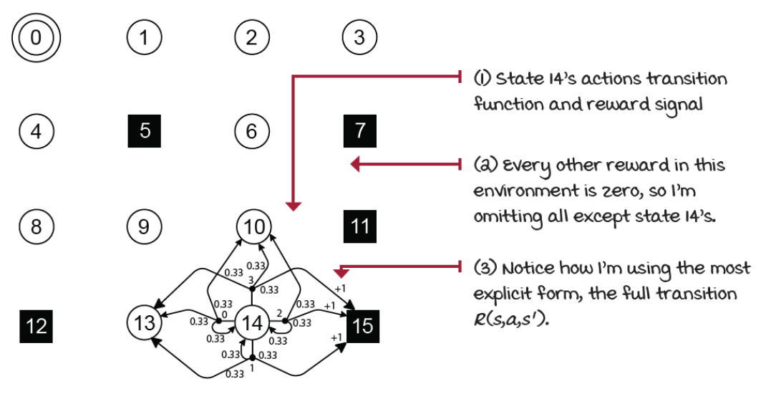
Example: the frozen lake (5)
The reward function is +1 for landing in state 15, 0 otherwise
See “notebook - frozen-lake.ipynb”

Slide 24
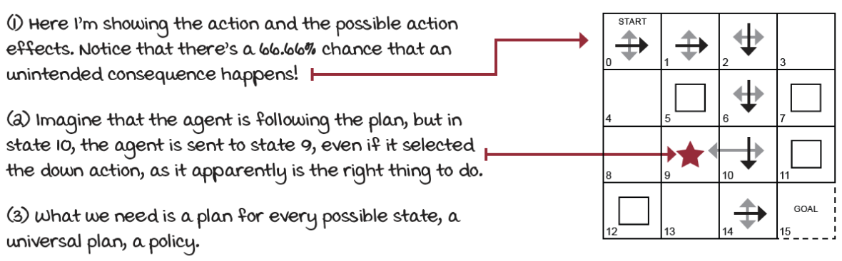
Plan
At first, it seems the agent’s goal is to find a sequence of actions that will maximize the return (sum of rewards)
something called a plan, a sequence of actions from the initial state to the target state
This isn’t enough! Plan don’t account for stochasticity in environments
actions taken won’t always work the way we intend.
what happen if our agent lands on a state not covered by the plan?

Slide 25

Policy
We need a policy: a universal plan, that covers all possible states
stochastic or deterministic: can return action-probability distributions or single actions for a given state:
How much reward should we expect from a policy?
the returns is enough
In the example: even though agent acts optimally, the environment might send it to an hole
the agent is looking to maximize the expected return: in order to take into account the environment’s stochasticity
We need methods to find a policies

